Slide 1
AL!VE
Association of Leaders in Volunteer Engagement
March 2013 Board Meeting

Slide 2
2013 Leadership Team
Leadership:
President: Kathy Cahill
President Elect: Beth Whitmire
Secretary: Kathryn Hampton
Treasurer: Joanna Johnson
Past President: Rob Bonesteel
VP Marketing: Nikki Russell
VP Membership: Karen McDonald
VP Programs: Emilie Bromet-Bauer
Board of Directors:
Tammy Baumann
Douglas Blankinship
Deanna Cole
Harriett Edwards
Jenna Jones
Suz McIver
Alan Monroe
Joy Pietschmann
Paula Pratt
Debbie Ray

Slide 3
Meeting Agenda
Review Minutes -
Treasure Report - Joanna
VP Reports
Marketing – Nikki
Membership – Karen
Programs – Emilie
Regional Roundtables – Beth W
Other Business
Adjourn
EC stay on call after for a quick update
Notes:
Sharing a historical overview of AL!VE
Discussing mission and vision of our national professional organization
Presenting benefits of membership – training options
Offering suggestions for building a professional network
Collecting input to insure that AL!VE is positioned as your essential resource for volunteer management information

Slide 4
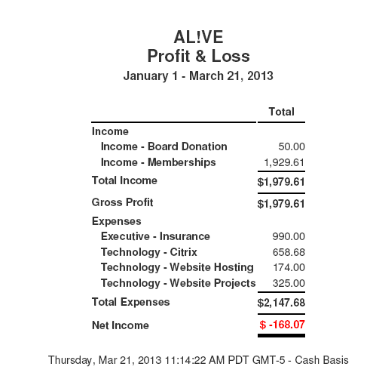
AL!VE First Quarter Profit & Loss Report

Slide 5
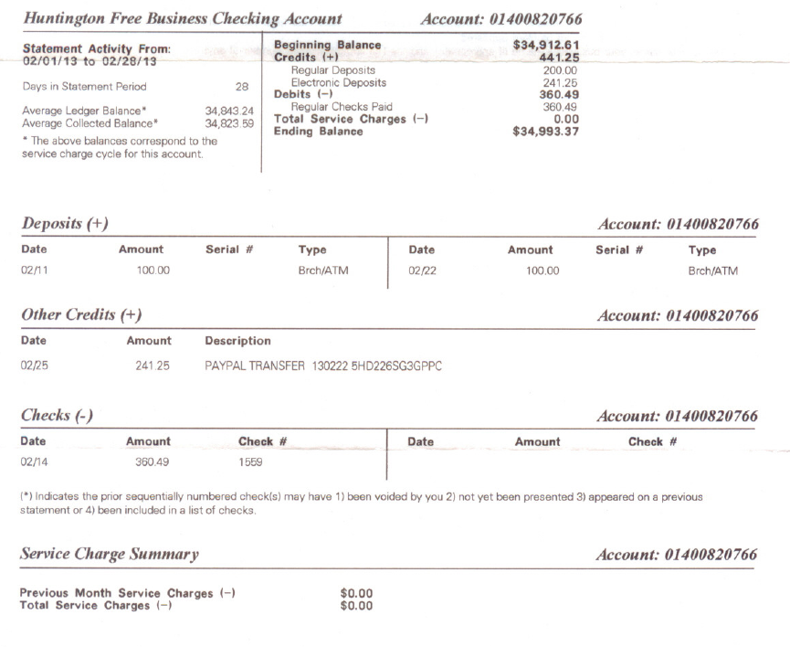
AL!VE Feb Bank Statement

Slide 6
AL!VE First Quarter 2013 Success
January
2013 work plan was accepted and started working on
2013 Budget was accepted
Board Development Training on the website
AL!VE Board Meeting
Financial review – Hendrix’s Regional Health
1099 submitted
Marketing Team started the development of the Business Case Document
Advocacy and Leadership team met

Slide 7
AL!VE First Quarter 2013 Success
February
Website upgrade when LIVE
First Blog posted on website
Business Manager contract updated/reviewed
AL!VE Executive Committee meeting
Regional Roundtable Program development

Slide 8
AL!VE First Quarter 2013 Success
March
Winter Newsletter
NCVS Booth purchased
NCVS Team developed
AL!VE Board Meeting
Group Member Round Table met

Slide 9
AL!VE First Quarter 2013 Success
Social Media
Twitter – 1,546 followers
Facebook - 323 Likes
Linked In – Has blown up!! Great discussions
Pinterest – 173 followers 12 boards 110 pins
Website Visitors 1/1/13- 3/20/13
78.47%New Visitor 226 Visits
21.53%Returning Visitor 62 Visits

Slide 10
Vice President Reports

Slide 11
Regional Roundtables Info

